Slide 1

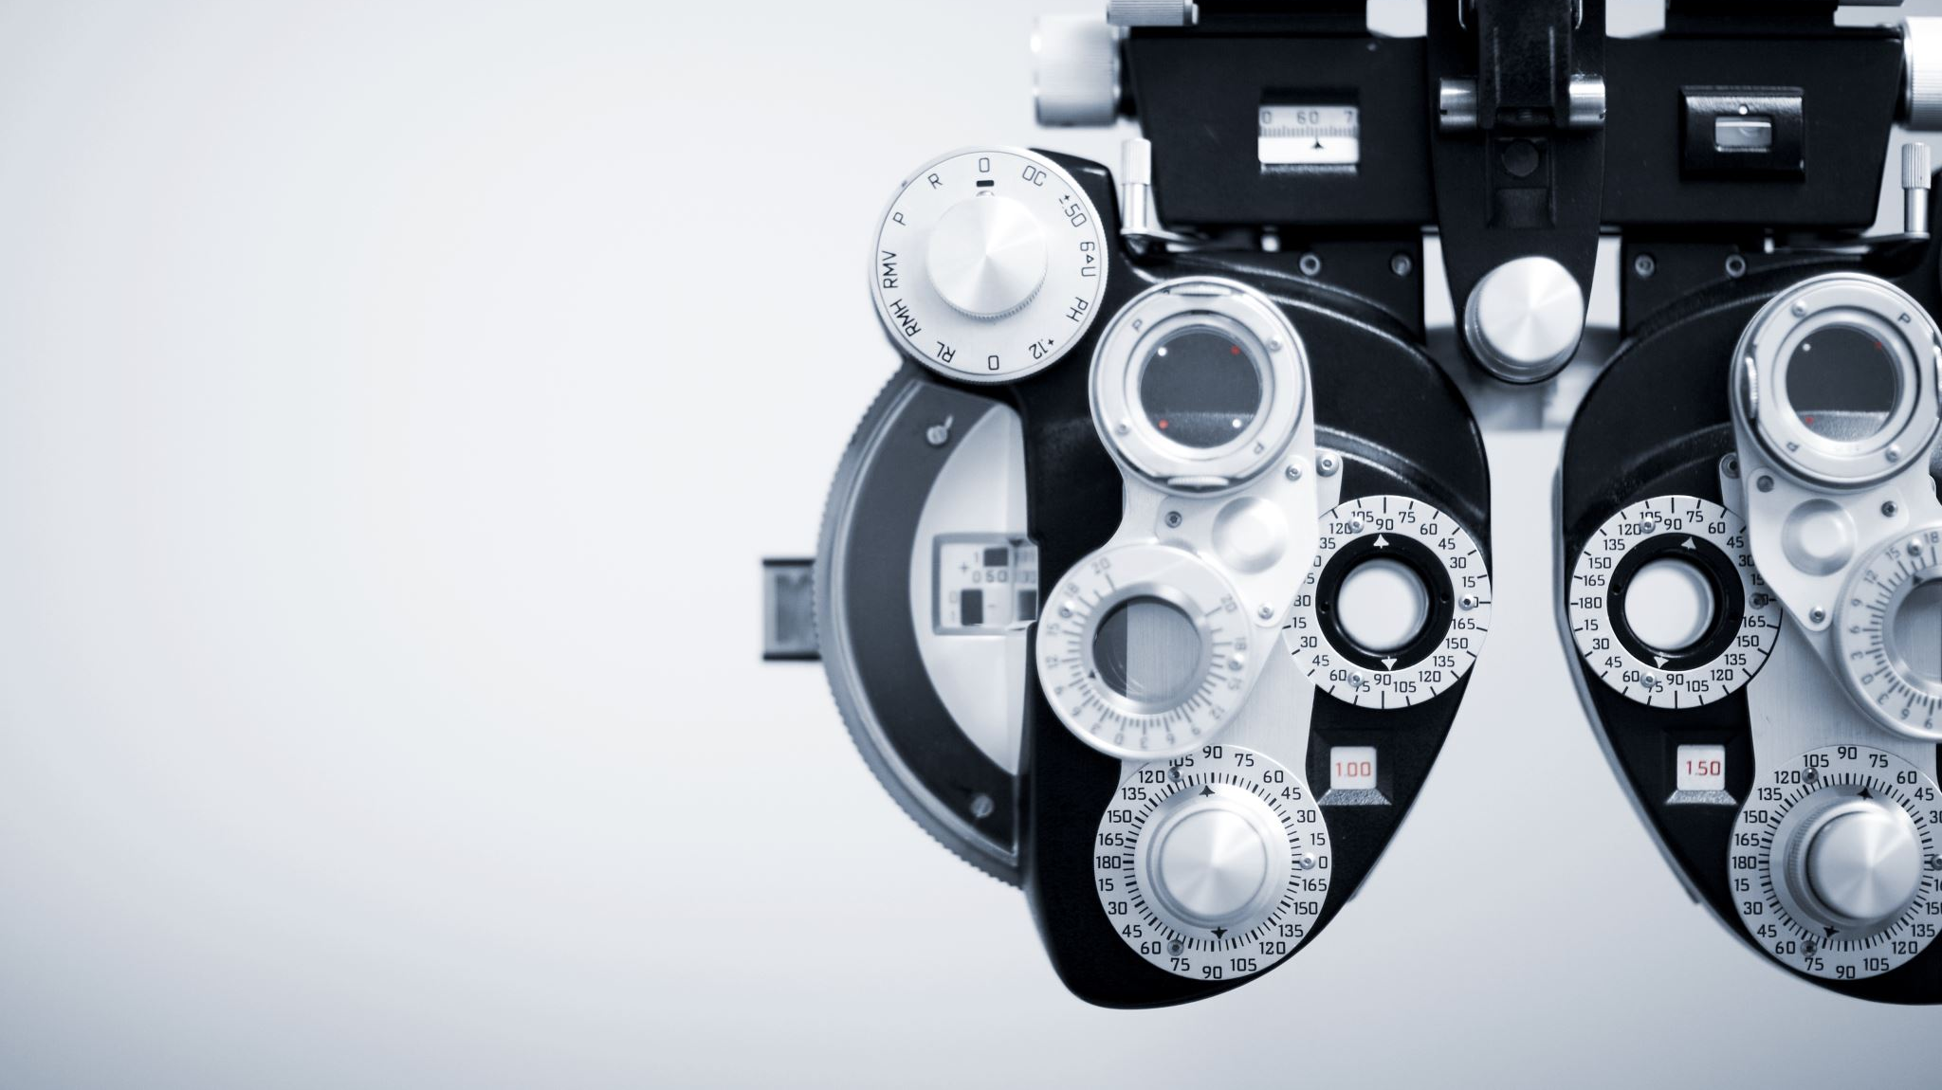
Snomed CT + Mimic Integration
By Mohammed Shoyeb

Slide 2
ICD2Vec: Mathematical representation of diseases(May 2023)
Introduction:
ICD2Vec transforms ICD-10 codes into vector embeddings that capture semantic and biological relationships among diseases.
Demonstrates how these embeddings:
Preserve medical meaning
Reflect biological data
Enable disease risk prediction using the ICD2Vec Risk Score (IRIS).
Method Used:
Embedding Framework
Uses NLP models to encode:
ICD-10 definitions, synonyms, and clinical descriptions
Into dense numerical vectors
Pretrained Models Used:
TF-IDF
FastText
BERT
BioBERT
Bio+ClinicalBERT
GatorTron (fine-tuned on ICD corpus)

Slide 3
Training Process:
Fine-tuning: Masked Language Modeling (MLM) on ICD-10 definitions
Embedding extraction: Sentence-level vectors using average pooling of last hidden layer
Implementation: Python + Hugging Face + NVIDIA NeMo
Evaluation Techniques:
Analogical reasoning: Vector arithmetic for semantic relations
Biological validation:
Compare cosine similarity of ICD2Vec vectors with:
Disease comorbidity risks
Network proximity of diseases
Genetic correlations (GWAS)
Datasets:
Training Data:
ICD-10-CM codes: 24,354 codes
139k+ medical terms with synonyms and descriptions
Data from NIH and MedlinePlus
Validation Datasets:
UK Biobank: 500,000+ participants
Samsung Medical Center (SMC): 209,000+ EHR patients (2010–2020)

Slide 4
Evaluation Metrics:
Cosine Similarity: Disease vector relationships
Pearson Correlation: Biological associations
Risk Prediction Metrics:
Hazard Ratios (HR)
AUROC for 8 major diseases
Example: CAD Prediction → AUROC ≈ 0.59, HR = 2.15
Model Architecture:
Data Preparation: Extract disease names, synonyms, and tokenize text
Embedding Generation: Fine-tune BERT-based models → vector (768–1024D) per ICD code
Relationship Validation: Compare cosine similarities with comorbidity, network, and genetic data
Risk Score Generation: Compute IRIS from patient disease vectors
Evaluation: Compare against Med2Vec, ICD-Codex, TF-IDF baselines
Code Implementation:
Publicly available: GitHub: YeongChanLee/ICD2Vec
Frameworks used:
Python
Hugging Face Transformers
NVIDIA NeMo
Includes scripts for IRIS computation and validation

Slide 5
Gaps/limitations:
Interpretability: ICD2Vec similarities may not imply clinical causality
Data Dependence: Relies heavily on English ICD text quality
Ontology Limitation: Does not model procedures or findings (non-disease concepts)
Bias Risk: Pretrained models may inherit demographic bias
Integrate GPT-based embeddings
Expand to SNOMED CT and multilingual data
Enhance interpretability using ontology-guided attention

Slide 6
AnnoDash, a clinical terminology annotation dashboard(oct 2023)
Introduction
AnnoDash is an open-source dashboard designed for mapping local medical terms (e.g., “HR”, “Creatinine”) to standard terminologies such as:
SNOMED CT
LOINC
ICD-10
OMOP
Combines:
Fast candidate retrieval
Interactive visualization
Optional LLM-based re-ranking
Goal: Make clinical term annotation faster, more accurate, and context-aware.
Key Features
Multi-method search & candidate retrieval
Optional LLM re-ranking (GPT-3.5 / Cohere)
Interactive visual dashboard
Local ontology database (SQLite)
Docker-based deployment
Clinician usability tested

Slide 7
Methods – Framework Overview
Frontend & Backend:Implemented using Plotly Dash (Python) for interactivity & visualization.
Candidate Retrieval
Fuzzy Matching: Jaro–Winkler
TF-IDF Vector Search
SQLite FTS5 (Lucene Preprocessor)
LLM Re-ranking :Uses OpenAI GPT-3.5 or Cohere Re-rank API, Incorporates textual + numerical context
Visualization & Data Handling:
Visualization Tools:
Patient-level measurement distributions
Summary statistics
Time-series plots for verification
Database: SQLite relational DB
Deployment: Fully containerized with Docker
Cloud-ready: Includes GCP deployment template
Usability Testing:
Conducted pilot study with 4 clinical users
Collected qualitative feedback via questionnaires
Metrics:
Median annotation time ≈ 2.5 minutes
High perceived usability, flexibility, and deployability

Slide 8
Dataset & Ontologies
Dataset
Based on MIMIC-IV demo data (100 patients)
Ontologies Used
LOINC v2.73 → Lab tests
SNOMED CT (07/31/2022) → Clinical findings
ICD-10-CM 2022 → Diagnoses
OMOP v5 → Standardized concepts
Preprocessing
`Scripts build concept tables & Lucene indexes for retrieval efficiency.
Usability Metrics:
Median annotation time ≈ 2.5 min
Positive user feedback on speed, flexibility, and accuracy.
Code Implementation
Open-source: GitHub + Zenodo DOI
Frontend: Interactive dashboard with dropdowns & dynamic plots
Backend: SQLite for ontology storage, optional Lucene integration
Deployment: One-command Docker setup, demo MIMIC dataset included
LLM Module: Optional & disabled by default (to avoid API cost)

Slide 9
Model Architecture:
End-to-End Workflow
Input Layer: Upload/select local concepts (e.g., “HR”)
Candidate Generation:
Fuzzy
TF-IDF
SQLite/Lucene searches (parallel)
Candidate Matching: Similarity scoring + hover-over visualization
Optional LLM Re-ranking: Uses GPT/Cohere for semantic & numeric context
Visualization Dashboard: Distributions, time-series, validation plots
Annotation Storage: Final mappings stored in SQLite database
Research Gaps
No large-scale quantitative validation (e.g., precision@k, recall)
Evaluated only on MIMIC-IV demo data – limited generalization
Quantitative context not integrated into initial retrieval
Algorithms not optimized for large ontologies / dense vector search
No active learning or adaptive ranking via user feedback
Small usability study (n=4) → low statistical power

Slide 10
Enhancing healthcare process analysis through object-centric process mining: Transforming OMOP common data models into object-centric event logs(Aug 2024)
Introduction
Traditional patient-centric process mining focuses only on patient event sequences.
This paper introduces Object-Centric Process Mining (OCPM) — a method that captures multi-entity interactions across:
Patients
Providers
Devices
Presents a transformation pipeline from OMOP Common Data Model (CDM) → Object-Centric Event Logs (OCEL).
Enables multi-object workflow analysis for complex healthcare systems.
Validated using MIMIC-IV dataset.
Motivation
Healthcare involves interconnected entities (patients, staff, devices, medications)
Traditional process mining flattens these relationships → loss of context.
OCPM models these as linked objects and events, allowing:
Cross-entity process discovery
Better traceability and clinical insight
Richer workflow analytics

Slide 11
Methods Overview
Core Concept: Object-Centric Process Mining (OCPM)
Captures interactions between multiple entities.
Represents each object (patient, provider, device) and event with interlinked identifiers.
Two-Phase Transformation Framework
OMOP CDM → OMOP CDM4PM
Extracts and standardizes event/object/concept tables.
Maintains OMOP’s standardized vocabularies.
OMOP CDM4PM → OCEL
Maps entities and clinical events into OCEL format for OCPM tools.
SNOMED CT–Based Event Mapping
Uses SNOMED CT hierarchy to abstract events at multiple levels:
High-level: General activity (e.g., “Medication Administration”)
Mid-level: Specific category (e.g., “Antibiotic administration”)
Low-level: Exact procedure or lab test
Enables multi-granular process analysis — clinicians can zoom in/out on process detail.
Data Quality Framework
Evaluates:
Completeness: Event & object count preservation
Conformance: Structural consistency (e.g., visit durations, identifiers)
Plausibility: Logical alignment of relationships
Ensures data fidelity across the OMOP→OCEL transformation.

Slide 12
Datasets & Evaluation Metrics
Dataset: MIMIC-IV (Beth Israel Deaconess Medical Center, 2008–2019, ~257K patient visits).
Evaluation subsets:
MIMIC-IV-S (100 patients, mixed visits)
MIMIC-IV-IP (1,088 inpatient visits)
MIMIC-IV-ED (913 emergency visits)
Metrics:
Completeness: Check event and object counts before/after transformation.
Conformance: Validate patient counts, visit durations, and consistency.
Abstraction Quality: % reduction in event and event-type counts when moving from low- to high-level representation
Code Implementation
Open-source repository: : https://github.com/gyunamister/omop2ocel
Language: Python
Transformation utilities:
Converts OMOP tables (Procedure, Drug Exposure, Observation, Measurement, Condition) → OCEL
Utilizes OMOP vocabulary relationships for standard mapping
Compatible tools: PM4Py, ProM (for OCPM analysis)

Slide 13
Model Architecture:
Phase 1 – OMOP CDM → OMOP CDM4PM
Identify event tables: Procedure, Drug, Condition, Measurement, Observation
Identify object tables: Person, Visit, Provider, Care Site, Device
Build event–object and event–concept relationships
Phase 2 – OMOP CDM4PM → OCEL
Assign identifiers and timestamps
Define event types (High/Mid/Low SNOMED abstraction)
Define object types (patient, visit, provider, device)
Generate event ↔ object mappings
Produce OCEL files for process mining visualization
Research Gaps
No domain expert validation (limited clinical review)
Abstraction-level optimization missing (no automatic granularity tuning)
Scalability not yet tested on full-scale institutional datasets
Preprocessing rules for missing/inconsistent codes undefined
No integration with real-time or predictive process mining

Slide 14
Large language models vs human for classifying clinical document(Mar 2025)
Introduction
Evaluates how LLMs (ChatGPT-3.5 & GPT-4) compared to Machine Learning, SNOMED CT mapping, and human coders for ICD-10 classification of discharge summaries.
Goal: Improve clinical coding accuracy for billing, research, and patient care.
Focus: LLMs’ ability to handle ambiguous or unclassified records missed by ML/SNOMED.
Methods
1. Machine Learning (ML)
Models: Decision Tree, Naive Bayes, KNN, Logistic Regression, Random Forest.
Best: Random Forest (F1 ≈ 95%)
Features: CUIs extracted via cTAKES → Bag-of-Words (affirmed/negated terms).
Validation: 10-fold cross-validation.
2. SNOMED CT Mapping
Extract SNOMED terms → ICD-10 mapping (238K code pairs).
Truncated to ICD-10 Level-3 (e.g., A41.9 → A41).
Accuracy varied by disease (I25 = 89%, Z51 = 0.5%).
3. Large Language Models (LLMs)
Models: ChatGPT-3.5, GPT-4 (zero-shot)
Prompt: “As a clinical coder, would you assign [ICD-10 code]?”
Consistency: GPT-3.5 (57–67%), GPT-4 (86–89%)
GPT-4 accuracy = 22%, equal to median human coder.
4. Human Coders
Accuracy range: 10–47% (median 22%)

Slide 15
Model Architecture / Pipeline
Step-by-Step Workflow
Data Extraction: Retrieve discharge summaries from MIMIC-IV (2023).
Entity Recognition – cTAKES: Extract CUIs + SNOMED terms (including negations).
ML Path: CUIs → Bag-of-Words → Random Forest → ICD-10 prediction.
SNOMED Mapping Path: SNOMED concepts → Official mapping → ICD-10 prediction.
Integration & Comparison: Compare ML and SNOMED outputs and dentify overlaps and false negatives (802 “hard cases”).
LLM Evaluation Path: Feed hard cases to ChatGPT-3.5 and GPT-4 for classification.
Human Validation: 5 professional coders label same 100-sample subset.
Evaluation & Visualization: Compute accuracy & F1; visualize with Venn diagrams and bar charts.
Frameworks
Apache cTAKES (UIMA) – entity extraction
scikit-learn, pandas – ML pipeline
SNOMED mapping files – terminology alignment
OpenAI API – GPT evaluation

Slide 16
Dataset & Evaluation
Source: MIMIC-IV (331 k summaries, 145 k patients).
Target: Top 5 ICD-10 Level-3 categories (balanced binary datasets).
Tri-Stage Framework: ML + SNOMED → identify hard cases → LLM & Human comparison.
Research Gaps
LLMs not fine-tuned (only zero-shot).
Limited to top 5 ICD categories.
Small human comparison subset.
No explainability or CAC integration yet.
Minimal discussion of HIPAA/GDPR compliance.

Slide 17
Proposed solutions:
Process-aware LLM + Graph Fusion for Clinical Concept Linking
Linking MIMIC clinical mentions → SNOMED CT using LLM reasoning, ontology graph embeddings, and object-centric process context (OMOP→OCEL)
Goal: accurate, auditable mapping (including rare concepts), ontology augmentation, and clinician-in-the-loop correction.
Why this solution?
First end-to-end fusion of: LLM reasoning + graph embeddings + object-centric process context.
Improves mappings for rare concepts and process-disambiguation (e.g., lab vs. diagnosis vs. procedure mentions).
Produces audit bundles: LLM rationale + provenance + process snippet for clinician trust & regulatory needs.
Supports ontology augmentation (proposing missing SNOMED relations).

Slide 18
What prior work gives:
LLM vs Human (Mar 2025) — prompting recipes, few-shot protocols, evaluation bench for LLM vs clinicians, and LLM rationale templates.
ICD2Vec (May 2023) — ideas for learning dense code/disease embeddings, cosine-based similarity, and downstream risk-style tasks (adapt to SNOMED).
AnnoDash (Oct 2023) — human-in-the-loop UI, candidate retrieval + visualization patterns, annotation workflow, and collecting clinician feedback for active learning.
OMOP → OCEL (Aug 2024) — object-centric process extraction pipeline → temporal/object features for re-ranker inputs.
ICHI 2025 (Is-A static/dynamic embeddings) — transformer text-pair classifiers, training on historical snapshots for temporal generalization.
Smart Health 2025 (TransE multi-relation) — graph embedding approach and multi-relation prediction for proposing new relations at scale.

Slide 19
References:
ICD2Vec: Mathematical representation of diseases
https://www.sciencedirect.com/science/article/pii/S1532046423000825#s0020
AnnoDash, a clinical terminology annotation dashboard
https://pubmed.ncbi.nlm.nih.gov/37425489/
Enhancing healthcare process analysis through object-centric process mining
https://www.sciencedirect.com/science/article/pii/S153204642400100X
Large language models vs human for classifying clinical documents
https://www.sciencedirect.com/science/article/pii/S1386505625000176?via%3Dihub

